Slide 1

DR.SAMEH - CS
HOME
ABOUT
CONTENT
OTHERS
WI-IF IDS DEVICE
Team : shadow Empire
PAGE 1

Slide 2


DR.SAMEH - CS
HOME
ABOUT
CONTENT
OTHERS
INTRODUCTION
Wi-Fi networks are widely used today
Cyber attacks on wireless networks are increasing
Deauthentication attacks are dangerous threats
Team : Shadow Empire
PAGE 2

Slide 3
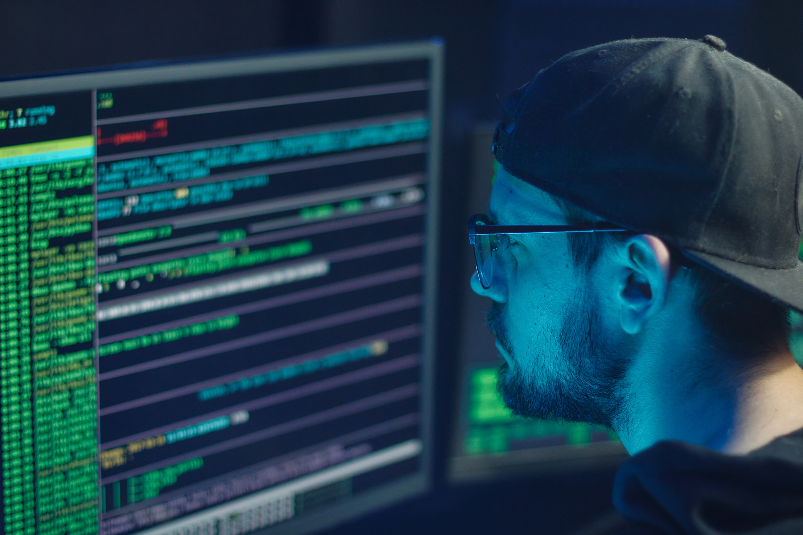

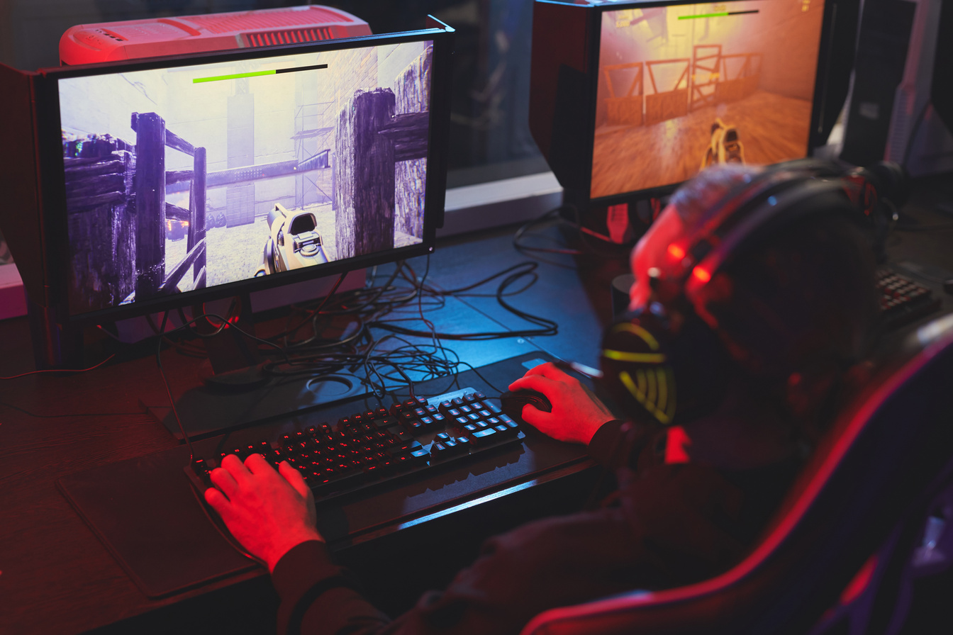

DR.SAMEH - CS
HOME
ABOUT
CONTENT
OTHERS
PROBLEM STATEMENT
THE ATTACK DISCONNECTS USERS FROM THE INTERNET
1.
2.
USERS CANNOT IDENTIFY THE REASON
3.
REAL-TIME LOW-COST DETECTION TOOLS ARE LIMITED
Team : Shadow Empire
PAGE 3

Slide 4
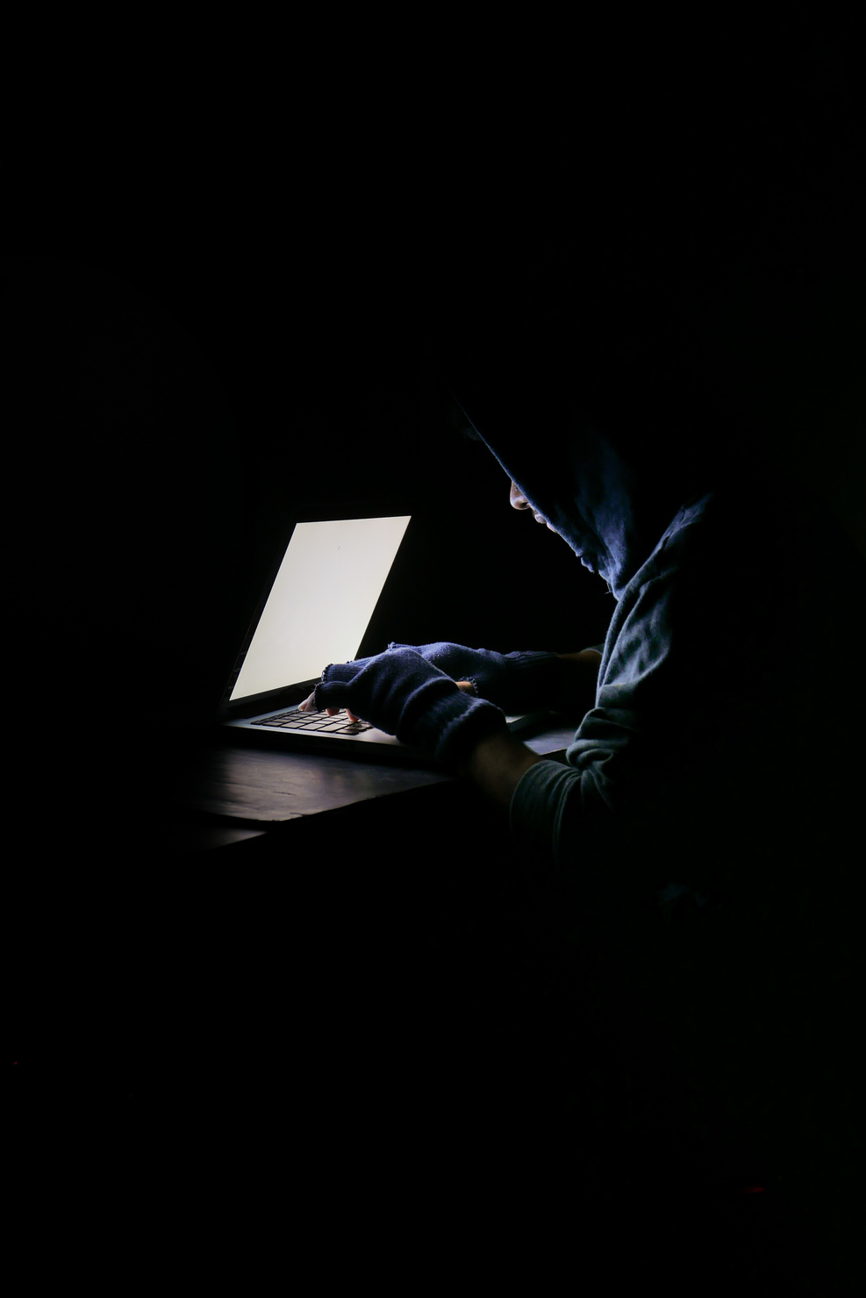
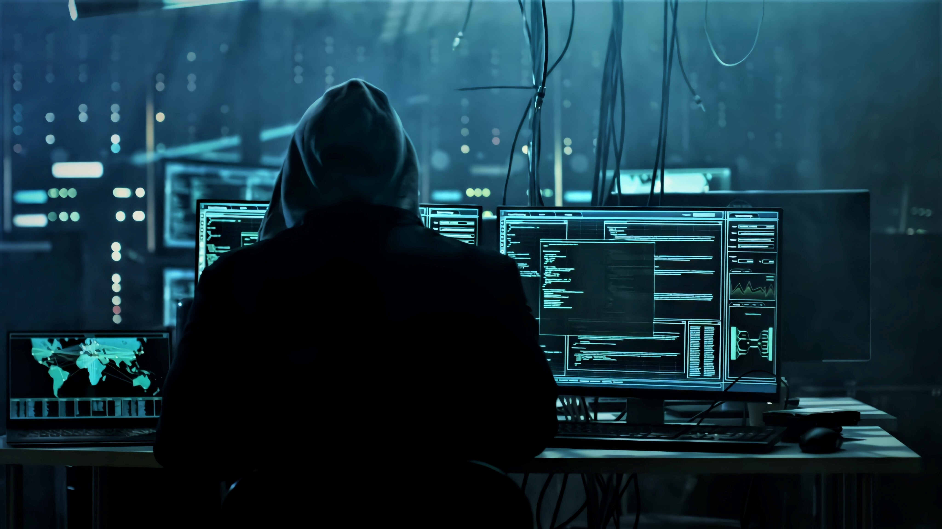
DR.SAMEH - CS
HOME
ABOUT
CONTENT
OTHERS
PROJECT IDEA
Building a Wi-Fi IDS device
Using ESP32 microcontroller
Detecting attacks in real-time
Team : shadow Empire
PAGE 4

Slide 5
DR.SAMEH - CS
HOME
ABOUT
CONTENT
OTHERS
INNOVATIVE CONCEPT
Using Promiscuous Mode
Capturing and analyzing packets
Detecting attacks instantly
Team : shadow Empire
PAGE 5

Slide 6

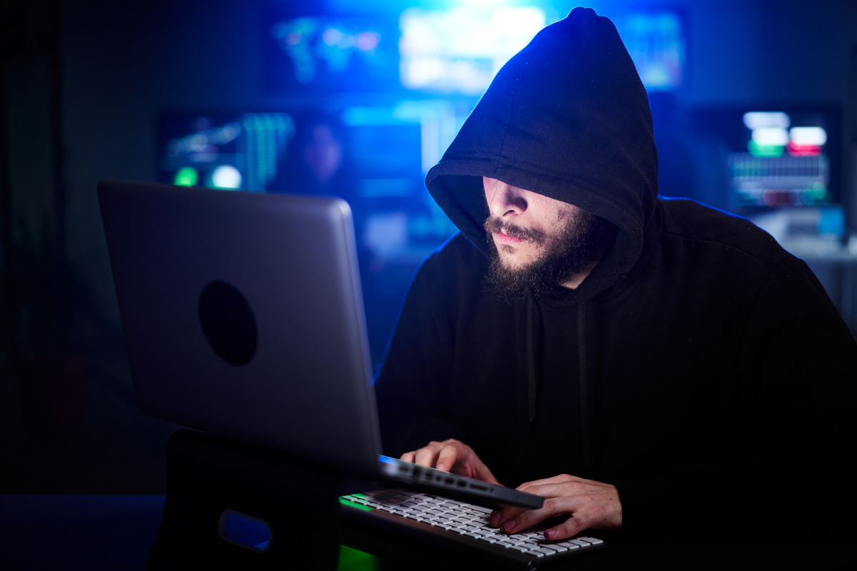
DR.SAMEH - CS
HOME
ABOUT
CONTENT
OTHERS
ADDED VALUE
1.
REAL-TIME DETECTION
2.
LOW-COST SOLUTION
3.
EASY TO USE
Team : Shadow Empire
PAGE 6

Slide 7
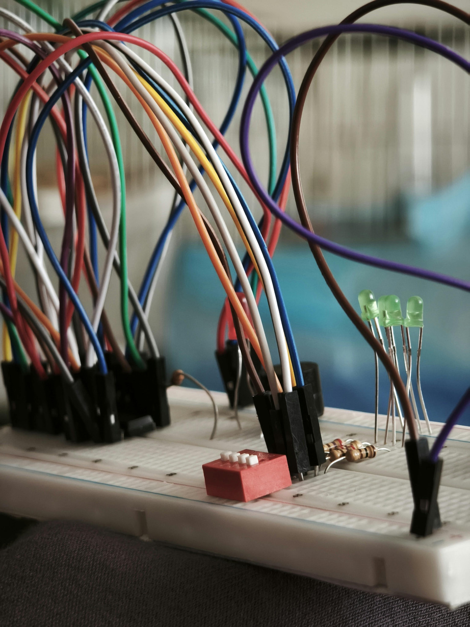
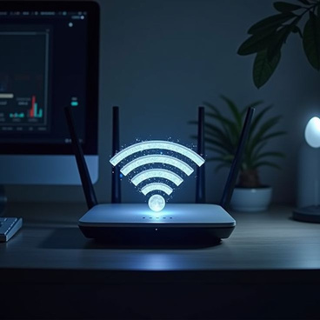
DR.SAMEH - CS
HOME
ABOUT
CONTENT
OTHERS
HARDWARE COMPONENTS
1.
ESP32
2.
LCD 2×16 DISPLAY
3.
Buzzer
4.
Jumper Wires
Team : Shadow Empire
PAGE 7

Slide 8


DR. SAMEH - CS
HOME
ABOUT
CONTENT
OTHERS
SYSTEM WORKING MECHANISM
1.
CAPTURE PACKETS
3.
DETECT ATTACK
2.
ANALYZE TRAFFIC
4.
TRIGGER ALARM
5.
DISPLAY DETAILS
Team : Shadow Empire
PAGE 8

Slide 9

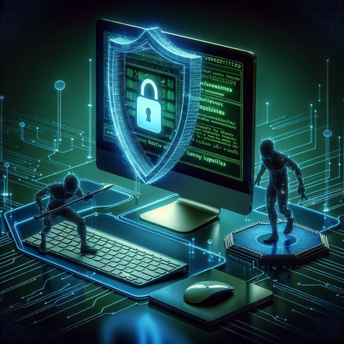
DR.SAMEH - CS
HOME
ABOUT
CONTENT
OTHERS
DETECTION & MONITORING
Attack Detection
Channel Number
RSSI Signal Strength
MAC Address
Team Shadow Empire
PAGE 9

Slide 10
DR.SAMEH - CS
HOME
ABOUT
CONTENT
OTHERS
ALERT SYSTEM
Activating buzzer
Warning message on LCD
Displaying details on Serial Monitor
Team : shadow Empire
PAGE 10

Slide 11
DR.SAMEH - CS
HOME
ABOUT
CONTENT
OTHERS
PROJECT FEATURES
STANDALONE DEVICE
FAST RESPONSE
EASY OPERATION
Team : shadow Empire
PAGE 11

Slide 12
DR.SAMEH - CS
HOME
ABOUT
CONTENT
OTHERS
TARGET USERS & MARKET
Home users
Small businesses
Anyone using Wi-Fi
Team: shadow Empire
PAGE 12

Slide 13

DR.SAMEH - CS
HOME
ABOUT
CONTENT
OTHERS
COST & ECONOMIC FEASIBILITY
Estimated cost: 700–900 EGP
Low production cost
Profitable project
Team: shadow Empire
PAGE 13

Slide 14
LICERIA & CO.
HOME
ABOUT
CONTENT
OTHERS
IMPACT & FUTURE DEVELOPMENT
1.
INCREASE CYBERSECURITY AWARENESS
2.
REDUCE ATTACK RISKS
3.
FUTURE AI INTEGRATION
www.reallygreatsite.com
PAGE 14

Slide 15
DR.SAMEH - CS
HOME
ABOUT
CONTENT
OTHERS
Conclusion
FINALLY, OUR PROJECT PROVIDES A SIMPLE AND EFFECTIVE WAY TO DETECT WI-FI ATTACKS IN REAL TIME.
Team: shadow Empire
PAGE 15

Slide 16
DR.SAMEH - CS
HOME
ABOUT
CONTENT
OTHERS
THANK YOU
Team Shadow Empire (Cs - dr.sameh)
Team: shadow Empire
PAGE 16

